Slide 1

HEALTHTECH
CODERUNNER

Slide 2
A picture of your team!
DEEP SATPUTE | TEJAS AGRAWAL | MAYUR KOLAKAR | SUSHANT PAWAR

Slide 3
Problem Statement
Manage unpredictable surges in patients during festivals, pollution spikes, or epidemics with an Al agent that autonomously analyzes data and recommends staffing, supply, and patient advisory actions in advance

Slide 4
Solution
Real-time AI data fetches live AQI, weather, disease info from internet (CPCB, IQAir, IMD)Intelligent prediction model with formulas: base cases + AQI impact + weather + festivalsAuto-generates staffing/supply recommendations when risk is highAuto-creates alerts for critical pollution or surge conditionsEnhanced AI Agent with better prompts, quick actions, and Hindi supportLive data banner showing current conditions on dashboardVoice input/output preserved in both English and Hindi

Slide 5
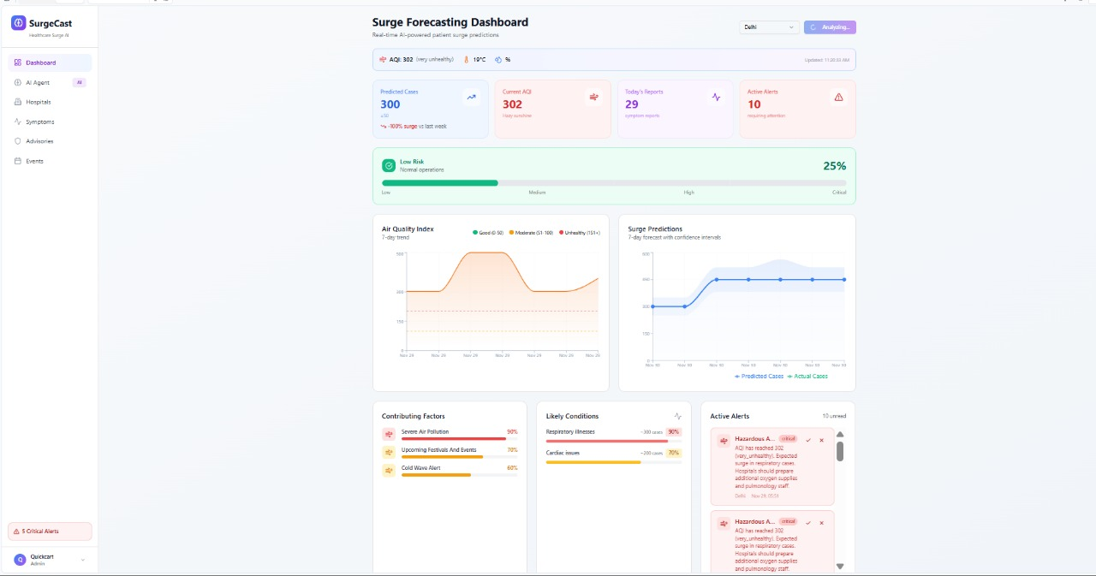
Screenshot 1

Slide 6
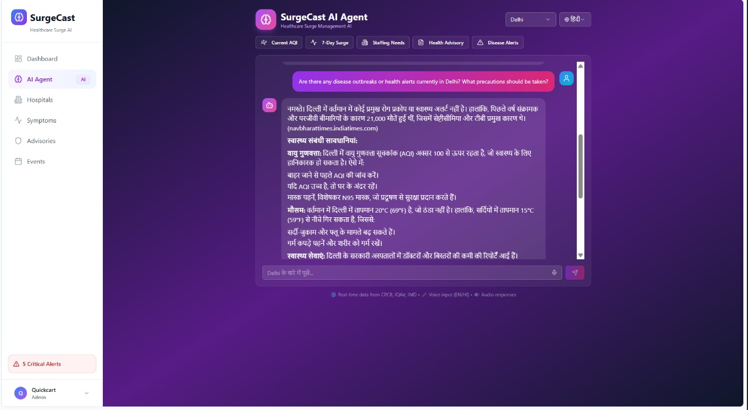
MULTIPLE LANGUAGE SUPPORT
Screenshot 2

Slide 7
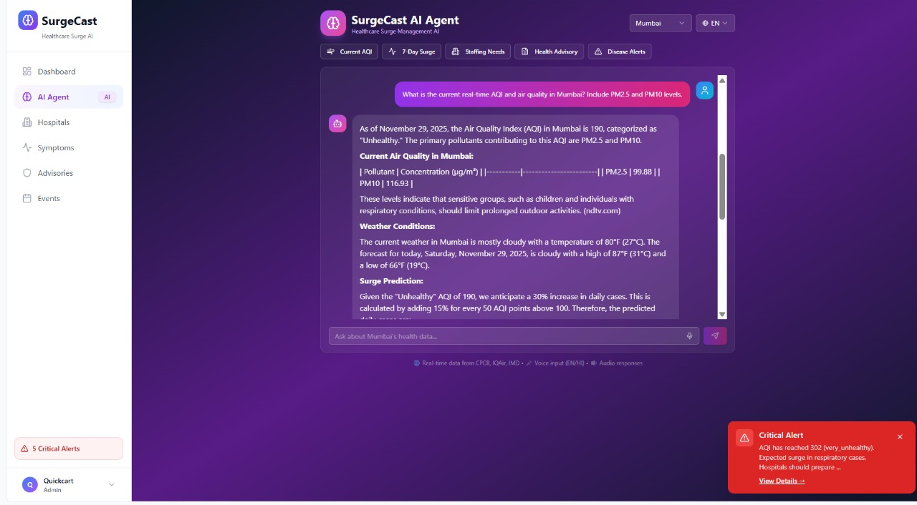
Screenshot 3

Slide 8
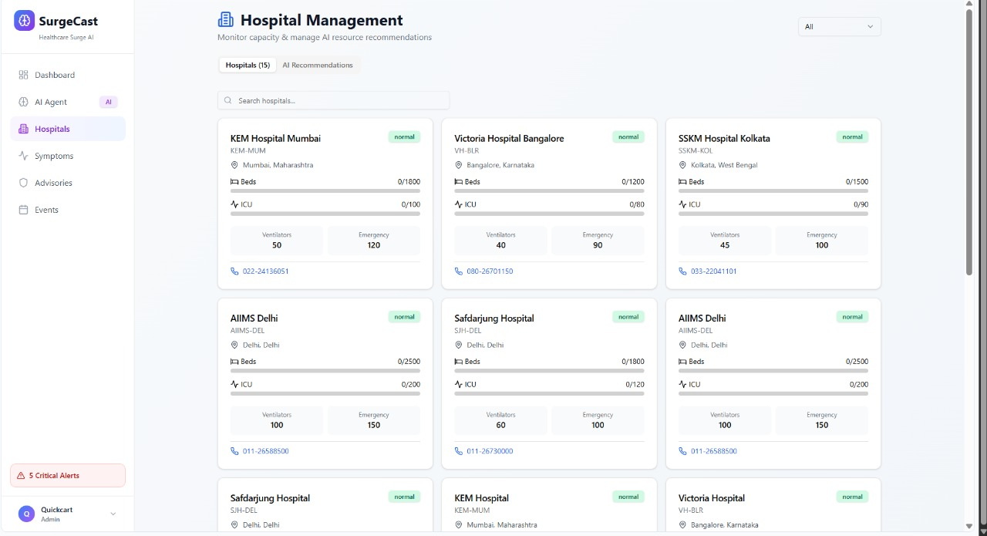
Screenshot 4

Slide 9
Business Model
Monthly/annual SaaS subscriptions for hospitals, schools, industries, and smart cities.
AI prediction APIs sold to developers and companies on a pay-per-use basis.
Custom enterprise dashboards and alert systems for large organizations.
Paid data analytics and forecast reports for health, pollution, and compliance.
Consumer mobile app revenue through ads and premium features.
The energy, collaboration, creativity, mentorship, and non-stop innovation made MumbaiHacks 2025 my favorite experience.

Slide 10
Thank you
The energy, collaboration, creativity, mentorship, and non-stop innovation made MumbaiHacks 2025 my favorite experience.

